Slide 1
Chapter 2: Wireless LANs

Slide 2
Characteristics of wireless LANs
Advantages
  Flexibility: very flexible within the reception area
  Planning: Ad-hoc networks without previous planning possible
  Design: (almost) no wiring difficulties (e.g. historic buildings, firewalls)
  Robustness: more robust against disasters like, e.g., earthquakes, fire or users pulling a plug
  Cost: Adding additional users to a wireless network will not increase the cost.
Disadvantages
  Quality of service: typically very low bandwidth compared to wired networks (1-10 Mbit/s)
  Proprietary solutions: many proprietary solutions, especially for higher bit-rates, standards take time (e.g. IEEE 802.11). Now, 802.11g is a popular solution.
  Restrictions: products have to follow many national restrictions if working wireless, it takes long time to establish global solutions like, e.g., IMT-2000
  Safety and security: Precautions have to be taken to prevent safety hazards. Secrecy and integrity must be assured.

Slide 3
Fundamentals of WLANs
Differences between wireless and wired transmission
  Address is not equivalent to physical location
  Dynamic topology and restricted connectivity
  Medium boundaries are not well-defined
  Error-prone medium
Use of WLANs
  Users can access the Internet on the move.
  WLANs are handy in areas affected by earthquakes or other disasters.
  WLANs are good solutions in places where wiring may not be permitted.

Slide 4
Design goals for wireless LANs
Operational simplicity
Power-efficient operations
License-free operation: no special permissions or licenses needed to use the LAN
Tolerance to interference
Global usability
Security: security (no one should be able to read my data), privacy (no one should be able to collect user profiles),
Safety requirement (low radiation)
Quality of service requirements
Compatibility with other technologies and applications

Slide 5
Comparison: Infrastructure vs. Ad-hoc networks
WLANs can be classified into two types:
  Infrastructure networks contains access points (APs) and mobile station (STAs).
  Ad hoc LANs do not need any fixed infrastructure.
Infrastructure networks
  Provide access to other networks
  Include forwarding functions
  Medium access control
Ad-hoc networks is a group of computers each with wireless adapters, connected as an independent wireless LAN.
  Each node can communicate with other nodes

Slide 6


Comparison: infrastructure vs. ad-hoc networks
Infrastructure
Network
AP: Access Point
AP
AP
Wired network
AP
Ad-hoc network

Slide 7
802.11 Services
Distribution Services (for APs)
  Association – mobile stations connect themselves to base stations
  Reassociation – a station may change its preferred base station
  Disassociation – the station or base station breaks the association Distribution – determines how to route frames sent to the base station
  Integration – handles the translation from the 802.11 format to the format of the destination network
Intracell Services (for STAs and APs)
  Authentication – a station must authenticate itself before permitted to send data.
  Deauthentication – a authenticated station wanting to leave the network is deauthenticated.
  Privacy – manages the encryption and decryption. The algorithm specified is RC4 by Ronald Rivest of MIT.
  Data Delivery – not reliable.

Slide 8
IEEE 802.11 Standard
IEEE 802.11b is known as Wi-Fi (wireless Fidelity).
Mobile Stations (MTs) can operate two modes:
  Infrastructure mode, in which MTs can communicate with one or more APs which are connected to a WLAN.
  Ad hoc mode, in which MTs can communicate directly with each other without using an AP.
IEEE 802.11 supports two medium in the physical layer:
  Infrared
  Radio wave
The physical layer is subdivided into physical medium dependent (PMD) sublayer and physical layer convergence protocol (PLCP).
IEEE 802.11 used CSMA/CD for MAC.

Slide 9
802.11 - Architecture of an infrastructure network
802.11 LAN
Station (STA)
  terminal with access mechanisms to the wireless medium and radio contact to the access point
Basic Service Set (BSS)
  group of stations using the same radio frequency
Access Point (AP)
  station integrated into the wireless LAN and the distribution system
Portal
  bridge to other (wired) networks
Distribution System
  interconnection network to form one logical network (EES: Extended Service Set) based
  on several BSS
802.x LAN
STA₁
BSS₁
Access
Point
Portal
Distribution System
ESS
Access
Point
BSS₂
STA₂
802.11 LAN
STA₃
Notes:
9

Slide 10
802.11 - Architecture of an ad-hoc network
802.11 LAN
Direct communication within a limited range
  Station (STA):
  terminal with access mechanisms to the wireless medium
  Independent Basic Service Set (IBSS):
  group of stations using the same radio frequency
STA₁
IBSS₁
STA₃
STA₂
IBSS₂
STA₅
STA₄
802.11 LAN

Slide 11

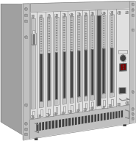

IEEE standard 802.11
fixed
terminal
mobile terminal
infrastructure
network
access point
application
application
TCP
TCP
IP
IP
LLC
LLC
LLC
802.11 MAC
802.11 MAC
802.3 MAC
802.3 MAC
802.11 PHY
802.11 PHY
802.3 PHY
802.3 PHY

Slide 12
Comparison: infrared vs. radio transmission
Infrared
  uses IR (Infra-Red) diodes, diffuse light, multiple reflections (walls, furniture etc.)
  Advantages
    simple, cheap, available in many mobile devices
    no licenses needed
    simple shielding possible
  Disadvantages
    interference by sunlight, heat sources etc.
    many things shield or absorb IR light
    low bandwidth
  Example
    IrDA (Infrared Data Association) interface available everywhere
Radio
  typically using the license free ISM (Industrial, Scientific, Medical) band at 2.4 GHz
  Advantages
    experience from wireless WAN and mobile phones can be used
    coverage of larger areas possible (radio can penetrate walls, furniture etc.)
  Disadvantages
    limited license free frequency bands
    shielding more difficult, interference with other electrical devices
  Example
    WaveLAN (Lucent), HIPERLAN, Bluetooth

Slide 13
802.11 - Layers and functions
PMD (Physical Medium Dependent) : modulation, encoding/decoding (coding)
PLCP (Physical Layer Convergence Protocol):
  provide a uniform abstract view for the MAC sublayer
  service access point (SAP) abstract the channel that offers up to 1 or 2 Mbps
  clear channel assessment (CCA) signal (carrier sense) used for CSMA/CA
PHY Management: channel selection, Management Information Base (MIB)
Station Management: coordination of all management functions
MAC: access mechanisms, fragmentation, encryption
MAC Management: synchronization, roaming, authentication, MIB, power management
Station Management
LLC
DLC
MAC
MAC Management
PLCP
PHY Management
PHY
PMD

Slide 14
802.11 Physical Layers
Infrared – 1 Mbps and 2 Mbps
  850-950 nm, infra-red light, typical 10 m range, encoded using PPM
FHSS (Frequency Hopping Spread Spectrum) uses 79 channels, each 1 MHz wide, starting in the 2.4 GHz band.
  A psudorandom number generator is used to produce the sequence of frequencies hopped to.
  The amount of time spent at each frequency, dwell time, is adjustable.
  spreading, despreading, signal strength, typical 1 Mbit/s
  min. 2.5 frequency hops/s (USA), 2-level GFSK modulation, 4-level GFSK for 2Mbit/s
DSSS (Direct Sequence Spread Spectrum) delivers 1 or 2 Mbps in the 2.4 GHz band.
  DBPSK modulation for 1 Mbit/s (Differential Binary Phase Shift Keying), DQPSK for 2 Mbit/s (Differential Quadrature PSK)
  preamble and header of a frame is always transmitted with 1 Mbit/s, rest of transmission 1 or 2 Mbit/s
  chipping sequence: +1, -1, +1, +1, -1, +1, +1, +1, -1, -1, -1 (Barker code)
  max. radiated power 1 W (USA), 100 mW (EU), min. 1mW

Slide 15
802.11 - Physical layer
802.11a uses OFDM (Orthogonal Frequency Division Multiplexing) to deliver up to 54 Mbps in the 5 GHz band.
Orthogonal Frequency Division Multiplexing, an FDM modulation technique for transmitting large amounts of digital data over a radio wave. OFDM works by splitting the radio signal into multiple smaller sub-signals that are then transmitted simultaneously at different frequencies to the receiver
802.11b uses HR-DSSS (High Rate Direct Sequence Spread Spectrum) to achieve 11 Mbps in the 2.4 GHz band.
802.11g uses OFDM to achieve 54 Mbps in the 2.4 GHz band.
The physical layer sensing is through the clear channel assessment (CCA) signal provided by the PLCP. The CCA is generated based on sensing of the air interface by:
  Sensing the detected bits in the air: more slowly but more reliable
  Checking the received signal strength (RSS): faster but no so precise

Slide 16
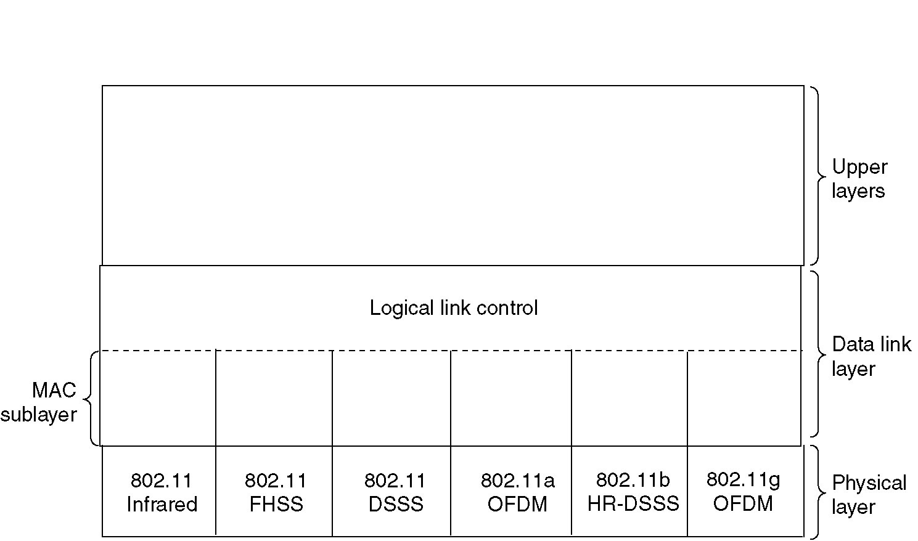
The 802.11 Protocol Stack
Part of the 802.11 protocol stack.

Slide 17
802.11 FHSS PHY Packet Format
Synchronization: synch with 010101... pattern
SFD (Start Frame Delimiter): 0000110010111101 start pattern
PLW (PLCP_PDU Length Word): length of payload incl. 32 bit CRC of payload, PLW < 4096
PSF (PLCP Signaling Field): data of payload (1 or 2 Mbit/s)
HEC (Header Error Check): CRC with x¹⁶+x¹²+x⁵+1
80
16
12
4
16
variable
synchronization
SFD
PLW
PSF
HEC
payload
bits
PLCP preamble
PLCP header

Slide 18
802.11 DSSS PHY Packet Format
Synchronization: synch., gain setting, energy detection, frequency offset compensation
SFD (Start Frame Delimiter): 1111001110100000
Signal: data rate of the payload (0A: 1 Mbit/s DBPSK; 14: 2 Mbit/s DQPSK)
Service: future use, 00: 802.11 compliant
Length: length of the payload
HEC (Header Error Check): protection of signal, service and length, x¹⁶+x¹²+x⁵+1
128
16
8
8
16
16
variable
bits
synchronization
SFD
signal
service
length
HEC
payload
PLCP preamble
PLCP header

Slide 19
WLAN: IEEE 802.11a
Data rate
  6, 9, 12, 18, 24, 36, 48, 54 Mbit/s, depending on SNR
  User throughput (1500 byte packets): 5.3 (6), 18 (24), 24 (36), 32 (54)
  6, 12, 24 Mbit/s mandatory
Transmission range
  100m outdoor, 10m indoor
    E.g., 54 Mbit/s up to 5 m, 48 up to 12 m, 36 up to 25 m, 24 up to 30m, 18 up to 40 m, 12 up to 60 m
Frequency
  Free 5.15-5.25, 5.25-5.35, 5.725-5.825 GHz ISM-band
Security
  Limited, WEP insecure, SSID
Cost: Check market
  adapter (a/b/g combo) $70, base station $160
Availability
  Some products, some vendors
Connection set-up time
  Connectionless/always on
Quality of Service
  Typ. best effort, no guarantees (same as all 802.11 products)
Manageability
  Limited (no automated key distribution, sym. Encryption)
Special Advantages/Disadvantages
  Advantage: fits into 802.x standards, free ISM-band, available, simple system, uses less crowded 5 GHz band
  Disadvantage: stronger shading due to higher frequency, no QoS

Slide 20
IEEE 802.11a – PHY Frame Format
4
1
12
1
6
16
variable
6
variable
bits
rate
reserved
length
parity
tail
service
payload
tail
pad
PLCP header
PLCP preamble
signal
data
12
1
variable
symbols
6 Mbit/s
6, 9, 12, 18, 24, 36, 48, 54 Mbit/s

Slide 21
WLAN: IEEE 802.11b
Data rate
  1, 2, 5.5, 11 Mbit/s, depending on SNR
  User data rate max. approx. 6 Mbit/s
Transmission range
  300m outdoor, 30m indoor
  Max. data rate ~10m indoor
Frequency
  Free 2.4 GHz ISM-band
Security
  Limited, WEP insecure, SSID
Cost: Check market
  Adapter $30, base station $40
Availability
  Many products, many vendors
Connection set-up time
  Connectionless/always on
Quality of Service
  Typ. Best effort, no guarantees (unless polling is used, limited support in products)
Manageability
  Limited (no automated key distribution, sym. Encryption)
Special Advantages/Disadvantages
  Advantage: many installed systems, lot of experience, available worldwide, free ISM-band, many vendors, integrated in laptops, simple system
  Disadvantage: heavy interference on ISM-band, no service guarantees, slow relative speed only

Slide 22
IEEE 802.11b – PHY Frame Formats
Long PLCP PPDU format
128
16
8
8
16
16
variable
bits
synchronization
SFD
signal
service
length
HEC
payload
PLCP preamble
PLCP header
192 µs at 1 Mbit/s DBPSK
1, 2, 5.5 or 11 Mbit/s
Short PLCP PPDU format (optional)
56
16
8
8
16
16
variable
bits
short synch.
SFD
signal
service
length
HEC
payload
PLCP preamble
(1 Mbit/s, DBPSK)
PLCP header
(2 Mbit/s, DQPSK)
96 µs
2, 5.5 or 11 Mbit/s

Slide 23
WLAN: IEEE 802.11g
Data rate
  OFDM: 6, 9, 12, 18, 24, 36, 48, 54 Mbit/s CCK: 1, 2, 5.5, 11 Mbit/s
  User throughput (1500 byte packets): 5.3 (6), 18 (24), 24 (36), 32 (54)
  6, 12, 24 Mbit/s mandatory
Transmission range
  300m outdoor, 30m indoor
    E.g., 54 Mbit/s up to 5 m, 48 up to 12 m, 36 up to 25 m, 24 up to 30m, 18 up to 40 m, 12 up to 60 m
Frequency
  Free 2.4 – 2.497 GHz ISM-band
Security
  Limited, WEP insecure, SSID
Cost: Check market
  Adapter $50, base station $50
Availability
  more products, more vendors
Connection set-up time
  Connectionless/always on
Quality of Service
  Typ. best effort, no guarantees (same as all 802.11 products)
Manageability
  Limited (no automated key distribution, sym. Encryption)
Special Advantages/Disadvantages
  Advantage: fits into 802.x standards, free ISM-band, available, simple system
  Disadvantage: heavy interference on ISM-band, no service guarantees

Slide 24
Wireless LAN Standard
Standard | Modulation | Spectrum | Max physical Rate | Working distance
802.11 | WDM, FHSS DSSS | 2.4 GHz | 2 Mbps | ≈100 m
802.11a | OFDM | 5 GHz | 54 Mbps | ≈ 50 m
802.11b | HR-DSSS | 2.4 GHz | 11 Mbps | ≈ 200 m
802.11g | OFDM | 2.4 GHz | 54 Mbps | ≈ 200 m

Slide 25
Medium Access Control in Wireless LANs
Because there is higher error rate and signal strength is not uniform throughout the space in which wireless LANs operate, carrier detection may fail in the following ways:
  Hidden nodes:
    Hidden stations: Carrier sensing may fail to detect another station. For example, A and D.
    Fading: The strength of radio signals diminished rapidly with the distance from the transmitter. For example, A and C.
  Exposed nodes:
    Exposed stations: B is sending to A. C can detect it. C might want to send to E but conclude it cannot transmit because C hears B.
    Collision masking: The local signal might drown out the remote transmission.
An early protocol designed for wireless LANs is MACA (Multiple Access with Collision Avoidance).

Slide 26
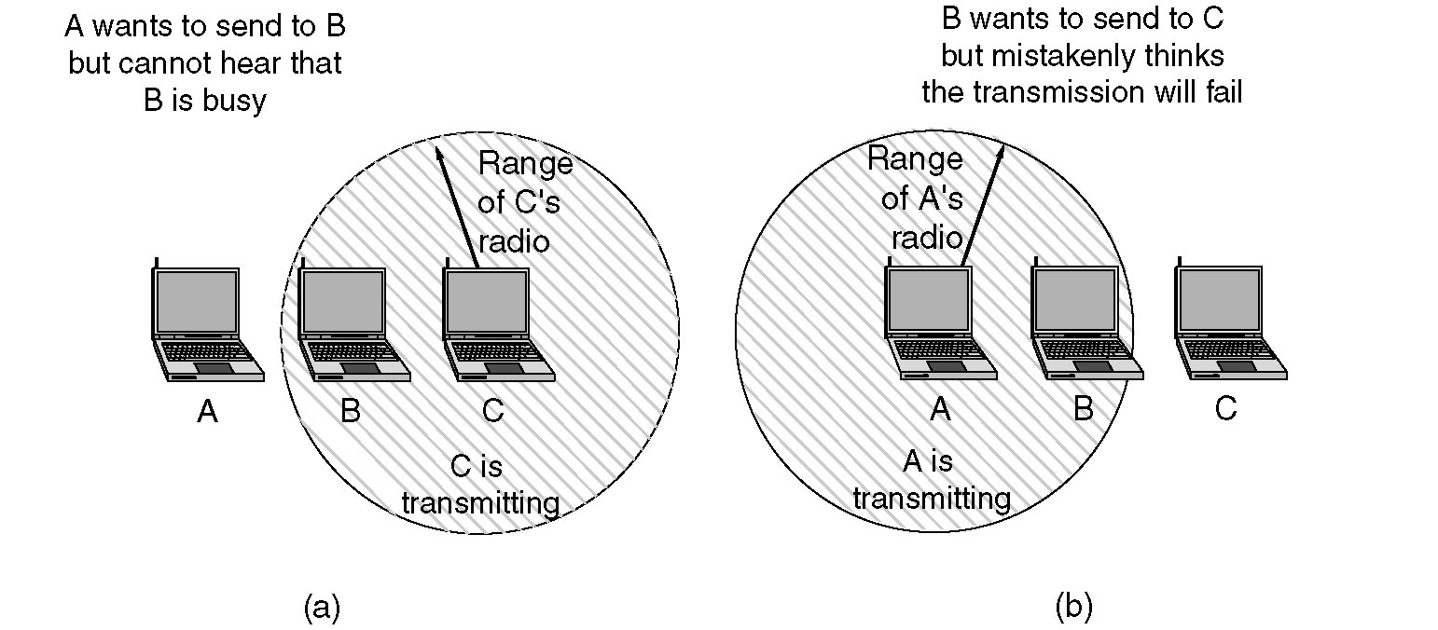
The 802.11 MAC Sublayer Protocol
(a) The hidden station problem.
(b) The exposed station problem.

Slide 27
MACA and MACAW
MACAW (MACA for Wireless) is a revision of MACA.
  The sender senses the carrier to see and transmits a RTS (Request To Send) frame if no nearby station transmits a RTS.
  The receiver replies with a CTS (Clear To Send) frame.
  Neighbors
    see CTS, then keep quiet.
    see RTS but not CTS, then keep quiet until the CTS is back to the sender.
  The receiver sends an ACK when receiving an frame.
    Neighbors keep silent until see ACK.
  Collisions
    There is no collision detection.
    The senders know collision when they don’t receive CTS.
    They each wait for the exponential backoff time.

Slide 28
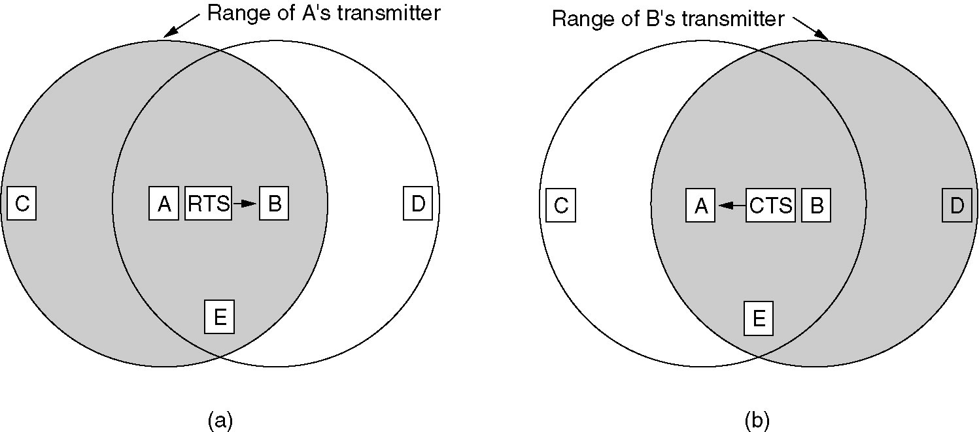
MACA Protocol
The MACA protocol. (a) A sending an RTS to B.
(b) B responding with a CTS to A.

Slide 29
802.11 MAC Sublayer
MAC layer tasks:
  Control medium access
  Roaming, authentication, power conservation
Traffic services
  DCF (Distributed Coordination Function) (mandatory): Asynchronous Data Service
    Only service available in ad-hoc network mode
    does not use any kind of central control
    exchange of data packets based on “best-effort”
    support of broadcast and multicast
  PCF (Point Coordination Function) (optional): Time-Bounded Service
    uses the base station to control all activity in its cell

Slide 30
802.11 MAC Sublayer
PCF and DCF can coexist within one cell by carefully defining the interframe time interval. The four intervals are depicted:
  SIFS (Short InterFrame Spacing) is used to allow the parties in a single dialog the chance to go first including letting the receiver send a CTS and an ACK and the sender to transmit the next fragment.
  PIFS (PCF InterFrame Spacing) is used to allow the base station to send a beacon frame or poll frame.
  DIFS (DCF InterFrame Spacing) is used to allow any station to grab the channel and to send a new frame.
  EIFS (Extended InterFrame Spacing) is used only by a station that has just received a bad or unknown frame to report the bad frame.
The result MAC scheme used in 802.11 is carrier sensing multiple access with collision avoidance (CSMA/CA) that is based on MACAW.
  Use NAV (Network Allocation Vector) to indicate the channel is busy.

Slide 31
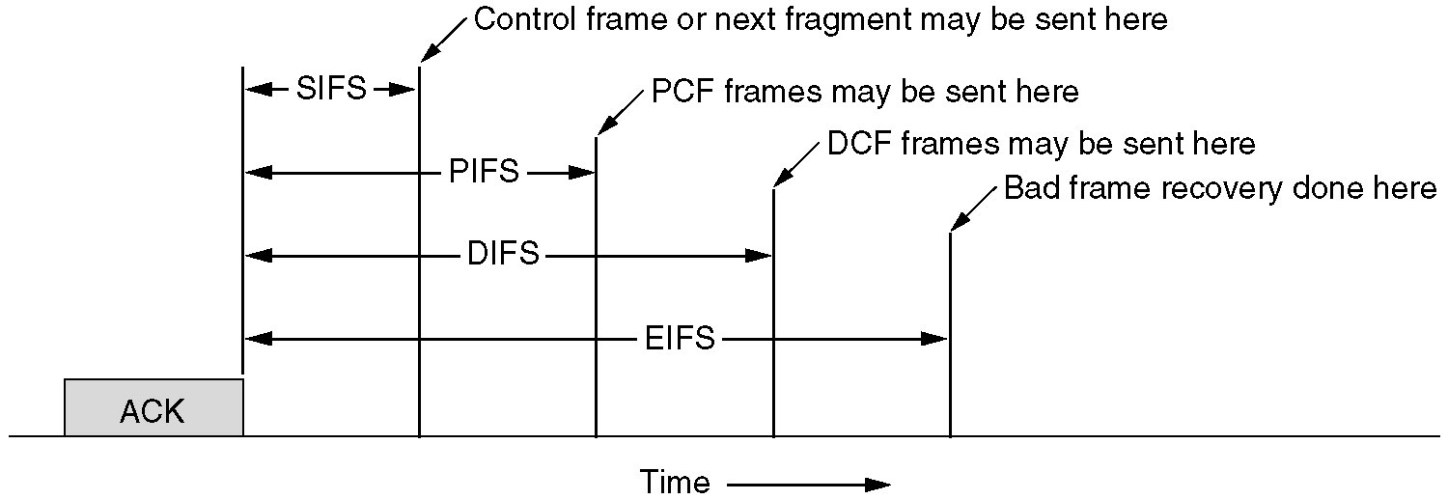
The 802.11 MAC Sublayer Protocol
Interframe spacing in 802.11.

Slide 32
802.11 MAC Sublayer
Access methods
  DFWMAC-DCF (distributed foundation wireless medium access control- Distributed Coordination Function) CSMA/CA (mandatory)
    collision avoidance via randomized „back-off“ mechanism
    minimum distance between consecutive packets
    ACK packet for acknowledgements (not for broadcasts)
  DFWMAC-DCF w/ RTS/CTS (optional)
    avoids hidden terminal problem
  DFWMAC- PCF (Point Coordination Function) (optional)
    access point polls terminals according to a list
    Completely controlled by the base station. No collisions occur.
    A beacon frame which contains system parameters is periodically (10 to 100 times per second) broadcasted to invite new stations to sign up for polling service.

Slide 33
802.11 - CSMA/CA access method
contention window
(randomized back-off
mechanism)
DIFS
DIFS
medium busy
next frame
direct access if
medium is free ≥ DIFS
t
slot time
Station ready to send starts sensing the medium (Carrier Sense based on CCA, Clear Channel Assessment)
If the medium is free for the duration of an Inter-Frame Space (IFS), the station can start sending (IFS depends on service type)
If the medium is busy, the station has to wait for a free IFS, then the station must additionally wait a random back-off time (collision avoidance, multiple of slot-time)
If another station occupies the medium during the back-off time of the station, the back-off timer stops (fairness)
Notes:
12

Slide 34
802.11 - CSMA/CA access method
Sending unicast packets
  station has to wait for DIFS before sending data
  receivers acknowledge at once (after waiting for SIFS) if the packet was received correctly (CRC)
  automatic retransmission of data packets in case of transmission errors
DIFS
data
sender
SIFS
ACK
receiver
DIFS
other
stations
data
t
waiting time
contention

Slide 35
802.11 MAC Frame format
Types
  control frames, management frames, data frames
Sequence numbers
  important against duplicated frames due to lost ACKs
Addresses
  receiver, transmitter (physical), BSS identifier, sender (logical)
Miscellaneous
  sending time, checksum, frame control, data
bytes
2
2
6
6
6
2
6
0-2312
4
Frame
Control
Duration/
ID
Address
1
Address
2
Address
3
Sequence
Control
Address
4
Data
CRC
bits
2
2
4
1
1
1
1
1
1
1
1
Protocol
version
Type
Subtype
To
DS
From
DS
More
Frag
Retry
Power
Mgmt
More
Data
WEP
Order

Slide 36
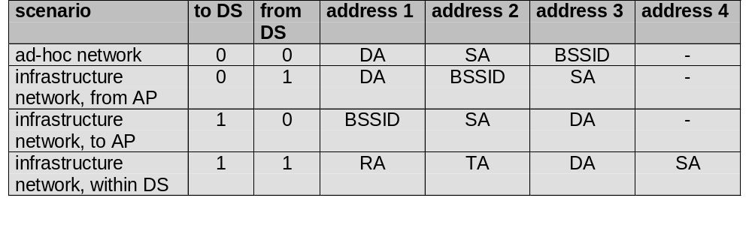
MAC address format
DS: Distribution System
AP: Access Point
DA: Destination Address
SA: Source Address
BSSID: Basic Service Set Identifier
RA: Receiver Address
TA: Transmitter Address
Ad-hoc network: packet exchanged between two wireless nodes without a distribution system
Infrastructure network, from AP: a packet sent to the receiver via the access point
Infrastructure network, to AP: a station sends a packet to another station via the access point
Infrastructure network, within DS: packets transmitted between two access points over the distribution system.

Slide 37
Special Frames: ACK, RTS, CTS
bytes
Acknowledgement
Request To Send
Clear To Send
2
2
6
4
ACK
Frame
Control
Duration
Receiver
Address
CRC
bytes
2
2
6
6
4
RTS
Frame
Control
Duration
Receiver
Address
Transmitter
Address
CRC
bytes
2
2
6
4
CTS
Frame
Control
Duration
Receiver
Address
CRC

Slide 38
WLAN: IEEE 802.11 – Current and Future Developments
802.11c provides required information to ensure proper bridge operations.
802.11d: Regulatory Domain Update – completed in 2001, amended in 2003
802.11e: MAC Enhancements – QoS – ongoing
  Enhance the current 802.11 MAC to expand support for applications with Quality of Service requirements, and in the capabilities and efficiency of the protocol.
802.11f: Inter-Access Point Protocol – completed in 2003
  Establish an Inter-Access Point Protocol for data exchange via the distribution system.
802.11h: Spectrum Managed 802.11a (DCS, TPC) – completed in 2003
802.11i: Enhanced Security Mechanisms – completed in 2004
  Enhance the current 802.11 MAC to provide improvements in security and replace Wired Equivalent Privacy (WEP).

